Slide 1
INTERNET SERVICE PROVIDER MANAGEMENT SYSTEM
Prof name: Shakila Shaikh
Presentation by:
Kanwaljit Singh (N114)
Sahil Sanap (N121)
Shreyas Kaushik (N124)

Slide 2
Presentation Agenda
Introduction
Project Overview
Project Workflow (EER)
Technologies Used
Schema Diagram
Query
Self Learning
Lessons Learned
Challenges Faced
References

Slide 3
Introduction
In the digital era, efficient management of data is crucial for businesses to thrive. Database Management Systems (DBMS) play a pivotal role in organizing, storing, retrieving, and managing vast amounts of data effectively.
This project aims to design and implement a comprehensive DBMS tailored to the needs of an ISP company. By leveraging database technologies, the company can streamline its operations, enhance decision-making processes, and improve overall efficiency.

Slide 4
Project Overview
Account and Subscription Management: The DBMS will handle account creation, subscription plans, billing information, and payment processing. It will allow customers to subscribe to different entertainment packages and manage their accounts seamlessly.
Service Request and Ticketing: The system will enable customers to raise service requests for issues such as connectivity problems, equipment setup, or technical support. It will also incorporate a ticketing system to track the status and resolution of service requests efficiently.

Slide 5
Project Overview
Router and Network Management: For customers using internet services, the DBMS will manage router installations, configurations, and network connectivity. It will track information about routers, including model details, MAC addresses, installation dates, and connected network nodes.
Invoice Generation and Payment Processing: The system will generate invoices for customers based on their subscription plans and usage. It will handle payment processing, tracking due dates, payment amounts, and payment methods, ensuring timely and accurate billing.

Slide 6
Project Overview
Administrative Tools: The DBMS will include administrative tools for managing user access levels, permissions, and system settings. It will provide an intuitive interface for administrators to monitor database activity, generate reports, and perform maintenance tasks.
By implementing this comprehensive DBMS, the company aims to optimize its operations, enhance customer satisfaction, and stay competitive in the dynamic Internet Service Prividing industry landscape.

Slide 7
Project Workflow (EER)

Slide 8
Technologies Used
MySQL
MySQL is an open-source relational database management system (RDBMS) that allows users to store, organize, and retrieve data efficiently using structured query language (SQL).
PlantUML
PlantUML is an open-source tool that allows users to create UML (Unified Modeling Language) diagrams using a simple and intuitive text-based syntax.

Slide 9
Technologies Used
Kaggle
Kaggle is an online platform for data science and machine learning competitions, datasets, and notebooks, providing a collaborative environment for data scientists and researchers to work on real-world problems.
Draw.io
Draw.io is a free online diagramming tool that enables users to create various types of diagrams, including flowcharts, network diagrams, and organizational charts, with a user-friendly interface and a wide range of customization options.

Slide 10
Technologies Used
Replit
Replit is an online integrated development environment (IDE) that allows users to write, compile, and run code in various programming languages directly from their web browser, offering features such as collaborative coding, version control, and deployment options.

Slide 11
Technologies Used
MySQL
Desc
PlanUML
Desc
Kaggle
Desc
Draw.io
Desc
Replit
Desc

Slide 12
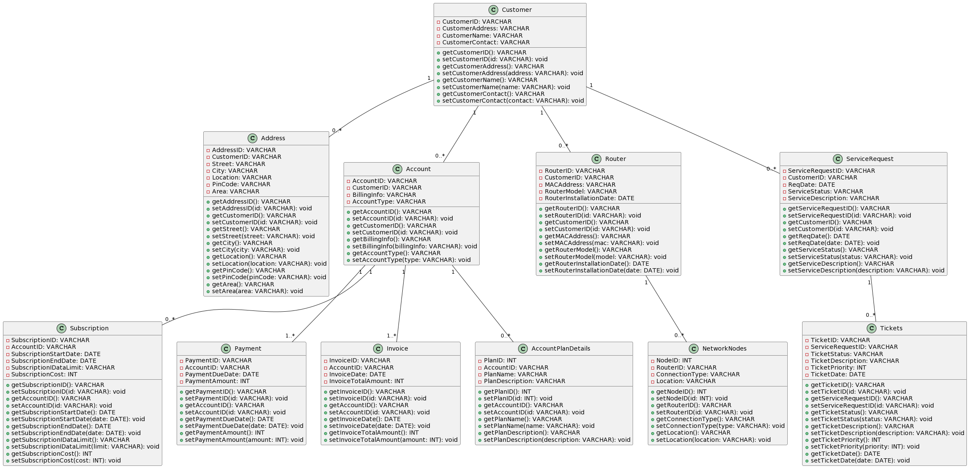
Schema Diagram

Slide 13
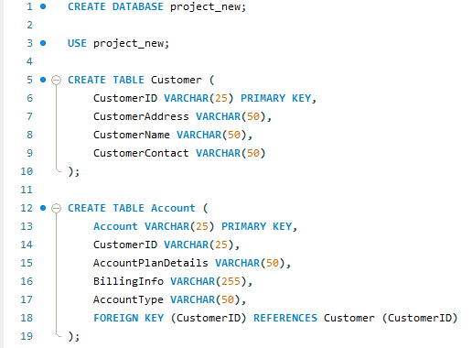
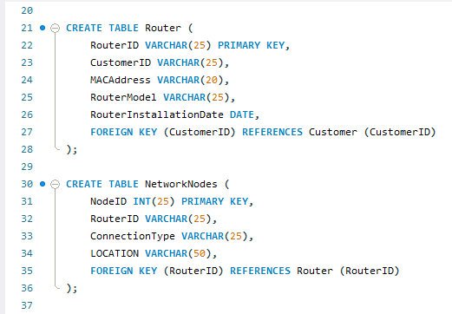
Queries - Table Creation

Slide 14
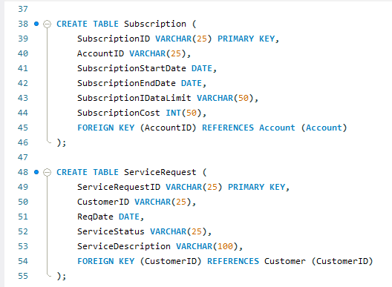
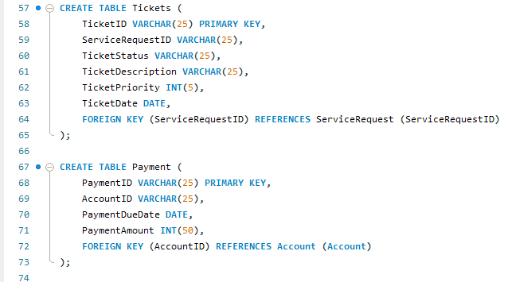
Queries

Slide 15
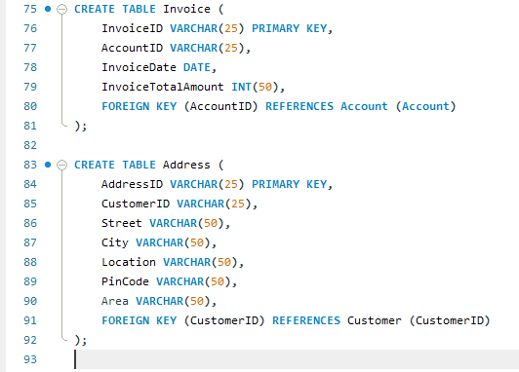
Queries

Slide 16
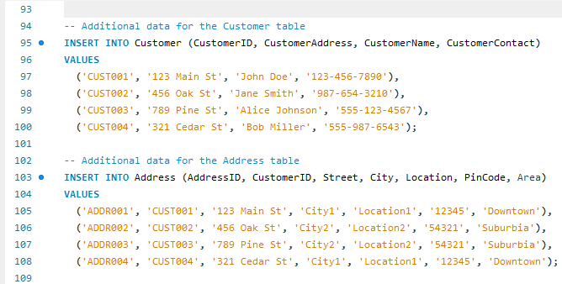
Queries - Insertion Into Table

Slide 17
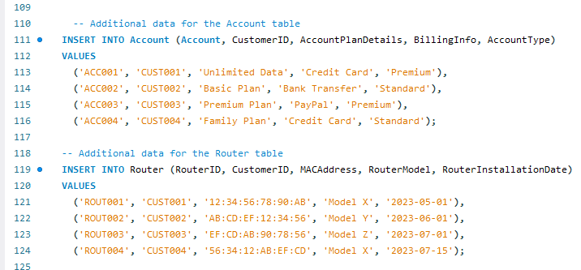
Queries

Slide 18
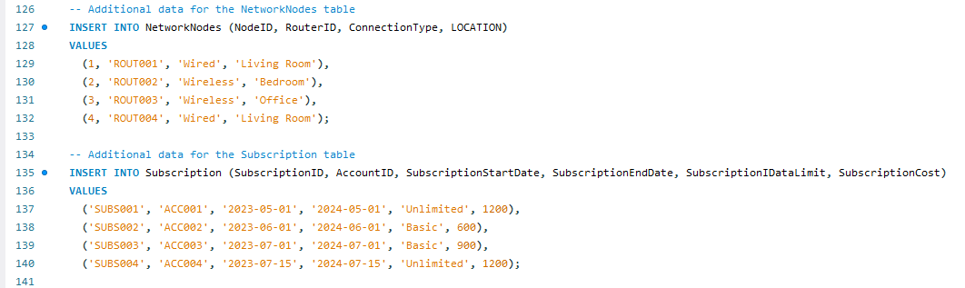
Queries

Slide 19
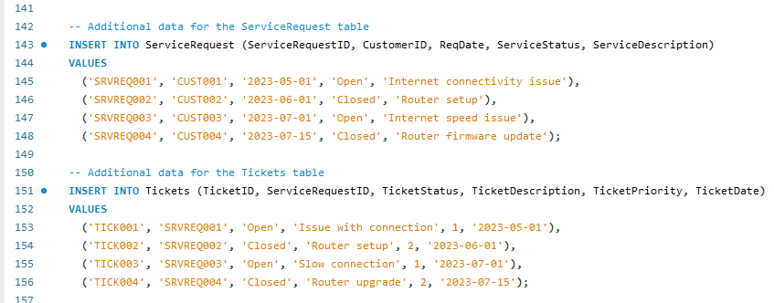
Queries

Slide 20
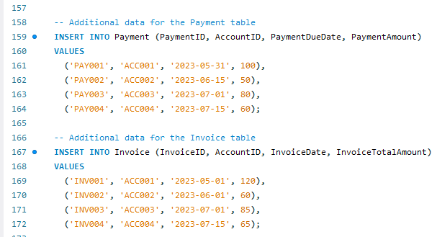
Queries

Slide 21
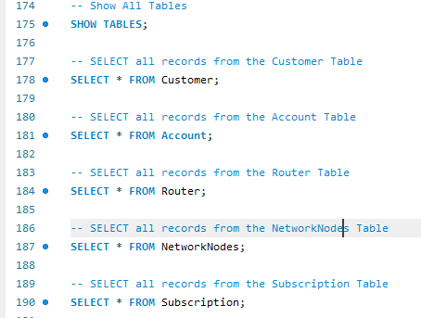
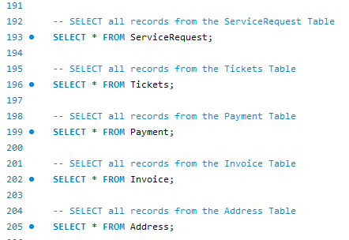
Queries - Show Tables

Slide 22
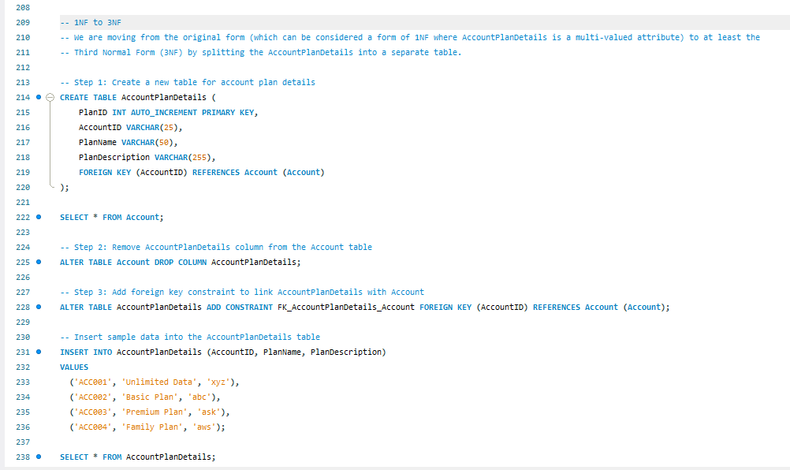
Queries - Normalization

Slide 23
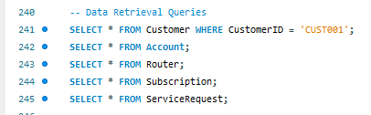
Queries -Data Retrieval

Slide 24
Queries - Data Analysis

Slide 25
Queries - Modification

Slide 26
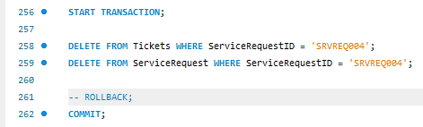
Queries - Modification (Transaction)

Slide 27
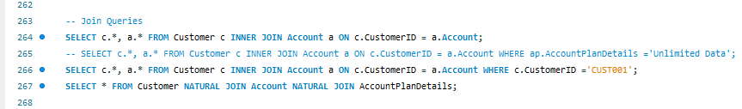
Queries - Joins

Slide 28

Queries - Aggregate

Slide 29

Queries - Filtering & Sorting

Slide 30
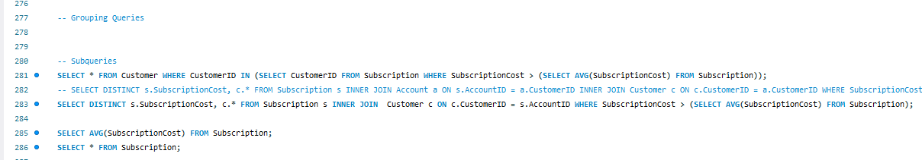
Queries - Grouping

Slide 31
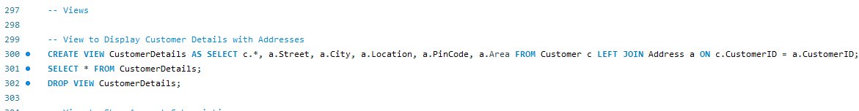
Queries - Views

Slide 32
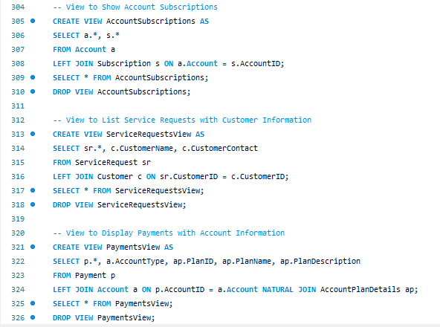
Queries - Views

Slide 33
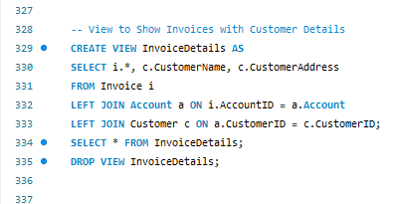
Queries - Views

Slide 34
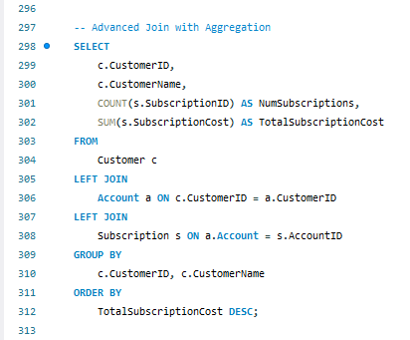
Queries - Advanced Aggregation

Slide 35
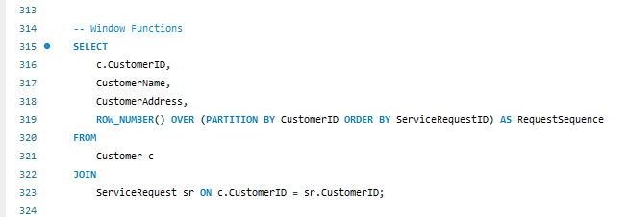
Queries - Window Function

Slide 36
Self Learning
Learned about new Technologies and Concepts like:
PlantUML
Open source resource to create diagrams based off of textual descriptions.
SVG Files
Used for website interfacing attempt.
ReplIT
Platform allowing simultaneous access to view and edit programs/codes between team members for better communication.
Advanced Projects for Complex Queries
Referred advanced DBMS Projects to formulate more complex queries which helped expand our knowledge and interest in the subject.

Slide 37
Lessons Learned
Deep dive into industry standard database management systems and hands-on experience with the creation of mid-to-advanced tier DBMS.
Used various sources to learn new, out-of-syllabus topics/ concepts/ Technologies such as PlantUML for Schema Diagram generation, Technologies like ReplIT for flexible code verification and team communication, Draw.io for EER Diagram, lastly, advanced projects for implementing more complex queries and functionalities.

Slide 38
Challenges Faced
Database Availability
Modularity
Learning Curve
Diagram Generation
Normalization
Simplification
Clean Code
Introducing Easy Backtracking on code

Slide 39
References
https://www.oracle.com/in/mysql/
https://replit.com/
https://app.diagrams.net/
https://plantuml.com/en-dark/
https://www.kaggle.com/datasets
https://github.com/topics/oracle

